Slide 1
COMP 2230
Week 15 - Wednesday

Slide 2
Last time
Reviewed second third of the course

Slide 3
Questions?

Slide 4
Assignment 6

Slide 5
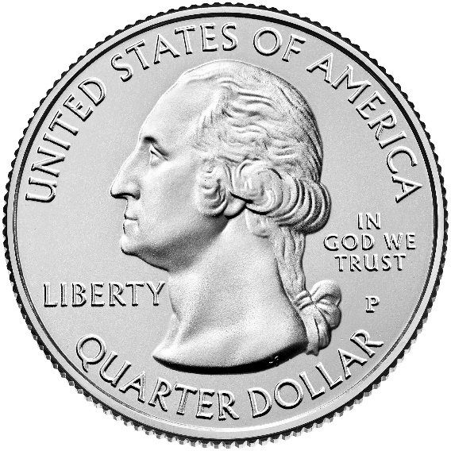
Logical warmup
A customer wants change for a dollar
The cashier cannot make change for a dollar
The customer asks for change for a half dollar
The cashier still can't
The (increasingly annoyed) customer asks for change for a quarter, a dime, and a nickel, but the cashier still can't
However, the cashier has $1.15 in coins
Which coins are in the cash register?

Slide 6
Final exam
Final exam:
Wednesday, April 29, 2026
8:00 to 10:00 a.m.
50% longer than previous exams, but you'll have 100% more time
There will be short answer, diagrams, and proofs
It will be comprehensive but weighted toward the last quarter of the course

Slide 7
Graphs and Trees

Slide 8
Graphs
A graph $G$ is made up of two finite sets
Vertices: $V(G)$
Edges: $E(G)$
Each edge is connected to either one or two vertices called its endpoints
An edge with a single endpoint is called a loop
Two edges with the same sets of endpoints are called parallel
Edges are said to connect their endpoints
Two vertices that share an edge are said to be adjacent
A graph with no edges is called empty

Slide 9
Special graphs
A simple graph does not have any loops or parallel edges
Let $n$ be a positive integer
A complete graph on $n$ vertices, written $K_{n}$, is a simple graph with $n$ vertices such that every pair of vertices is connected by an edge
A bipartite graph is a simple graph whose vertices can be partitioned into sets $X$ and $Y$ such that there are no edges from any vertex in $X$ to another vertex in $X$ and there are no edges from any vertex in $Y$ to another vertex in $Y$
A complete bipartite graph on $(m, n)$ vertices, written $K_{m,n}$ is a simple graph with a set of $m$ vertices and a disjoint set of $n$ vertices such that:
There is an edge from each of the $m$ vertices to each of the $n$ vertices
There are no edges among the set of $m$ vertices
There are no edges among the set of $n$ vertices
A subgraph is a graph whose vertices and edges are a subset of another graph

Slide 10
Degree
The degree of a vertex is the number of edges that are incident on the vertex
The total degree of a graph $G$ is the sum of the degrees of all of its vertices
What's the relationship between the degree of a graph and the number of edges it has?
What's the degree of a complete graph with $n$ vertices?
Note that the number of vertices with odd degree must be even

Slide 11
Example
What is the maximum number of edges a simple disconnected graph with $n$ vertices can have?
Prove it.

Slide 12
Definitions
A walk from $v$ to $w$ is a finite alternating sequence of adjacent vertices and edges of $G$, starting at vertex $v$ and ending at vertex $w$
A walk must begin and end at a vertex
A path from $v$ to $w$ is a walk that does not contain a repeated edge
A simple path from $v$ to $w$ is a path that does not contain a repeated vertex
A closed walk is a walk that starts and ends at the same vertex
A circuit is a closed walk that does not contain a repeated edge
A simple circuit is a circuit that does not have a repeated vertex other than the first and last

Slide 13
Circuits
If a graph is connected, non-empty, and every node in the graph has even degree, the graph has an Euler circuit
Algorithm to find one:
Pick an arbitrary starting vertex
Move to an adjacent vertex and remove the edge you cross from the graph
Whenever you choose such a vertex, pick an edge that will not disconnected the graph
If there are still uncrossed edges, go back to Step 2
A Hamiltonian circuit must visit every vertex of a graph exactly once (except for the first and the last)
If a graph $G$ has a Hamiltonian circuit, then $G$ has a subgraph $H$ with the following properties:
$H$ contains every vertex of $G$
$H$ is connected
$H$ has the same number of edges as vertices
Every vertex of $H$ has degree 2

Slide 14
Matrix representations of graphs
To represent a graph as an adjacency matrix, make an $n× n$ matrix $a$, where $n$ is the number of vertices
Let the nonnegative integer at $a_{ij}$ give the number of edges from vertex $i$ to vertex $j$
A simple graph will always have either $1$ or $0$ for every location
We can find the number of walks of length $k$ that connect two vertices in a graph by raising the adjacency matrix of the graph to the $k$^{th} power

Slide 15
Isomorphism
We call two graphs isomorphic if we can relabel one to be the other
Graph isomorphisms define equivalence classes
Reflexive: Any graph is clearly isomorphic to itself
Symmetric: If $x$ is isomorphic to $y$, then y must be isomorphic to $x$
Transitive: If $x$ is isomorphic to $y$ and $y$ is isomorphic to $z$, it must be the case that $x$ is isomorphic to $z$

Slide 16
Isomorphism invariants
A property is called an isomorphism invariant if its truth or falsehood does not change when considering a different (but isomorphic) graph
These cannot be used to prove isomorphism, but they can be used to disprove isomorphism
10 common isomorphism invariants:
Has $n$ vertices
Has $m$ edges
Has a vertex of degree $k$
Has $m$ vertices of degree $k$
Has a circuit of length $k$
Has a simple circuit of length $k$
Has m simple circuits of length $k$
Is connected
Has an Euler circuit
Has a Hamiltonian circuit

Slide 17
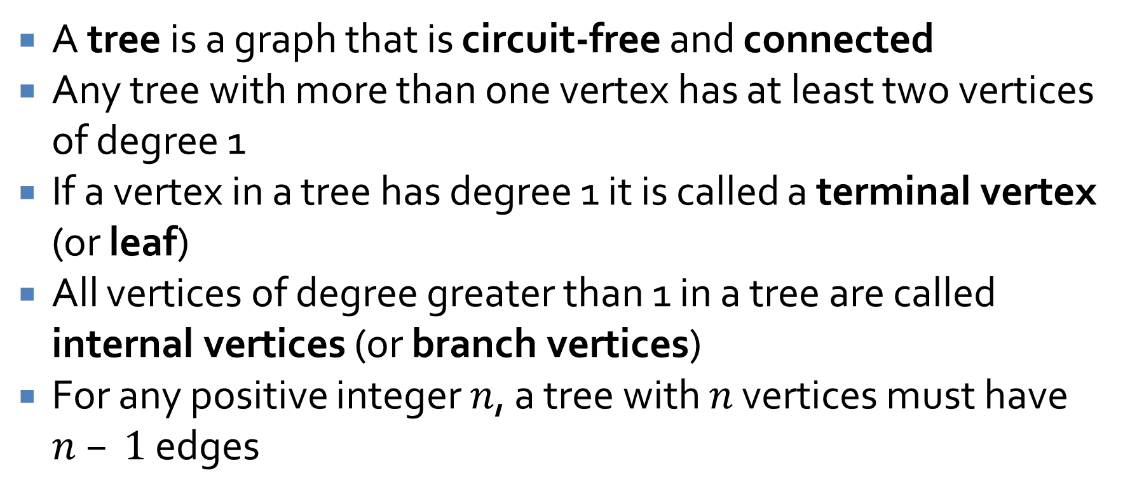
Trees
A tree is a graph that is circuit-free and connected
Any tree with more than one vertex has at least two vertices of degree 1
If a vertex in a tree has degree 1 it is called a terminal vertex (or leaf)
All vertices of degree greater than 1 in a tree are called internal vertices (or branch vertices)
For any positive integer $n$, a tree with $n$ vertices must have $n – 1$ edges

Slide 18
Rooted trees
In a rooted tree, one vertex is distinguished and called the root
The level of a vertex is the number of edges along the unique path between it and the root
The height of a rooted tree is the maximum level of any vertex of the tree
The children of any vertex $v$ in a rooted tree are all those nodes that are adjacent to $v$ and one level further away from the root than $v$
Two distinct vertices that are children of the same parent are called siblings
If $w$ is a child of $v$, then $v$ is the parent of $w$
If $v$ is on the unique path from $w$ to the root, then $v$ is an ancestor of $w$ and $w$ is a descendant of $v$

Slide 19
Binary trees
A binary tree is a rooted tree in which every parent has at most two children
Each child is designated either the left child or the right child
In a full binary tree, each parent has exactly two children
Given a parent $v$ in a binary tree, the left subtree of $v$ is the binary tree whose root is the left child of $v$
Ditto for right subtree

Slide 20
Spanning Trees

Slide 21
Spanning trees
A spanning tree for a graph $G$ is a subgraph of $G$ that contains every vertex of $G$ and is a tree
Some properties:
Every connected graph has a spanning tree
Why?
Any two spanning trees for a graph have the same number of edges
Why?

Slide 22
Weighted graphs
In computer science, we often talk about weighted graphs when tackling practical applications
A weighted graph is a graph for which each edge has a real number weight
The sum of the weights of all the edges is the total weight of the graph
Notation: If $e$ is an edge in graph $G$, then $w(e)$ is the weight of $e$ and $w(G)$ is the total weight of $G$
A minimum spanning tree (MST) is a spanning tree of lowest possible total weight

Slide 23
Finding a minimum spanning tree
Kruskal's algorithm gives an easy to follow technique for finding an MST on a weighted, connected graph
Informally, go through the edges, adding the smallest one, unless it forms a circuit
Algorithm:
Input: Graph $G$ with $n$ vertices
Create a subgraph $T$ with all the vertices of $G$ (but no edges)
Let $E$ be the set of all edges in $G$
Set $m = 0$
While $m < n – 1$
Find an edge $e$ in $E$ of least weight
Delete $e$ from $E$
If adding $e$ to $T$ doesn't make a circuit
Add $e$ to $T$
Set $m = m + 1$
Output: $T$

Slide 24
Prim's algorithm
Prim's algorithm gives another way to find an MST
Informally, start at a vertex and add the next closest node not already in the MST
Algorithm:
Input: Graph $G$ with $n$ vertices
Let subgraph $T$ contain a single vertex $v$ from $G$
Let $V$ be the set of all vertices in $G$ except for $v$
For $i$ from $1$ to $n – 1$
Find an edge $e$ in $G$ such that:
$e$ connects $T$ to one of the vertices in $V$
$e$ has the lowest weight of all such edges
Let $w$ be the endpoint of $e$ in $V$
Add $e$ and $w$ to $T$
Delete $w$ from $V$
Output: $T$

Slide 25
Growth of Functions

Slide 26
Growth of functions
Power functions:
$p_{a}(x) = x^{a}$ where $a,x≥0$
Increasing and decreasing functions
Let $f$ and $g$ be real-valued functions defined on the same set of nonnegative real numbers
$f$ is of order at least $g$, written $f(x)$ is $Ω(g(x))$, iff there is a positive $A∈ℝ$and a nonnegative $a∈ℝ$ such that
$A\left|g\left(x\right)\right|≤|f(x)|$ for all $x > a$
f is of order at most g, written $f(x)$ is $O(g(x))$, iff there is a positive $B∈ℝ$ and a nonnegative $b∈ℝ$ such that
$\left|f\left(x\right)\right|≤B|g(x)|$for all $x > b$
f is of order g, written $f(x)$ is $Θ(g(x))$, iff there are positive $A, B∈ℝ$ and a nonnegative $k∈ℝ$ such that
$A\left|g\left(x\right)\right|≤\left|f\left(x\right)\right|≤B|g(x)|$ for all $x > k$

Slide 27
Polynomials
Let $f(x)$ be a polynomial with degree n
$f(x) = a_{n}x^{n} + a_{n−1}x^{n−1} +a_{n−2}x^{n−2} … + a_{1}x + a_{0}$
By extension from the previous results, if $a_{n}$ is a positive real, then
$f(x)$ is $O(x^{s})$ for all integers $s≥ n$
$f(x)$ is $Ω(x^{r})$ for all integers $r≤n$
$f(x)$ is $Θ(x^{n})$

Slide 28
Running time for algorithms
First, assume that the number of operations performed by $A$ on input size $n$ is dependent only on $n$, not the values of the data
If $f(n)$ is $Θ(g(n))$, we say that $A$ is $Θ(g(n))$ or that $A$ is of order $g(n)$
If the number of operations depends not only on $n$ but also on the values of the data
Let $b(n)$ be the minimum number of operations where $b(n)$ is $Θ(g(n))$, then we say that in the best case, $A$ is $Θ(g(n))$ or that $A$ has a best case order of $g(n)$
Let $w(n)$ be the maximum number of operations where $w(n)$ is $Θ(g(n))$, then we say that in the worst case, $A$is $Θ(g(n))$ or that A has a worst case order of $g(n)$

Slide 29
Computing running time
With a single for (or other) loop, we simply count the number of operations that must be performed
When loops do not depend on each other, we can simply multiply their iterations (and asymptotic bounds)
When loops depend on each other, we should analyze the loops like a series
Repeated divisions by a constant $k$ often lead to a $\log_{k}{n}$ term

Slide 30
Formal Languages

Slide 31

Rules
We say that a language is a set of strings
A string is an ordered $n$-tuple of elements of an alphabet $Σ$ or the empty string $ε$ (which has no characters)
An alphabet $Σ$ is a finite set of characters

Slide 32
Notation
Let $Σ$ be some alphabet
For any nonnegative integer $n$, let
$Σ^{n}$ be the set of all strings over $Σ$ that have length $n$
$Σ^{+}$ be the set of all strings over $Σ$ that have length at least $1$
$Σ^{∗}$ be the set of all strings over $Σ$
$Σ^{∗}$ is called the Kleene closure of $Σ$ and the $∗$ operator is often called the Kleene star

Slide 33
Languages defined by a regular expression
For a finite alphabet $Σ$, the language $L(r)$ defined by a regular expression $r$ is as follows
Base: $L(∅) = ∅$, $L(ε) = \{ε\}$, $L(a) = \{a\}$ for every $a∈Σ$
Recursion: If $L(r)$ and $L(r′)$ are the languages defined by the regular expressions $r$ and $r′$ over $Σ$, then
$L(r r′) = L(r)L(r′)$
$L(r | r′) = L(r)∪L(r′)$
$L(r^{∗}) = {\left(L\left(r\right)\right)}^{∗}$

Slide 34
Finite-state automaton
A finite-state automaton is an idealized machine composed of five objects:
A finite set $I$, called the input alphabet, of input symbols
A set $S$ of states the automaton can be in
A designated state $s_{0}$ called the initial state
A designed set of states called the set of accepting states
A next-state function $N: S×I→S$ that maps a current state with current input to the next state

Slide 35
Transition diagram
FSA's are often described with a state transition diagram
The starting state has an arrow
The accepting states are marked with circles
Each rule is represented by a labeled transition arrow
The following FSA represents a vending machine
quarter
25¢
half-dollar
75¢
quarter
half-dollar
$1.25
0¢
quarter
half-dollar
quarter
quarter
quarter
50¢
$1
half-dollar
half-dollar
half-dollar

Slide 36
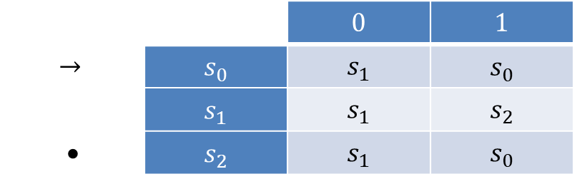
Annotated next-state tables
$$1$$
Consider this FSA:
We can also describe an FSA using an annotated next-state table
A next-state table gives shows what the transition is for each state for all possible input
An annotated next-state table also marks the initial state and accepting states
$$s_{0}$$
$$s_{1}$$
$$1$$
$$s_{2}$$
$$0$$
$$0$$
$$1$$
$$0$$
 |  | $$0$$ | $$1$$
$$→$$ | $$s_{0}$$ | $$s_{1}$$ | $$s_{0}$$
 | $$s_{1}$$ | $$s_{1}$$ | $$s_{2}$$
• | $$s_{2}$$ | $$s_{1}$$ | $$s_{0}$$

Slide 37
*-equivalence
Two states of a finite-state automaton are $∗$-equivalent if any string accepted by the automaton when it starts from one state is accepted when starting from the other
Given an automaton $A$ with eventual-state function $N^{∗}$, we can formally say:
States $s$ and $t$ in $A$ are $∗$-equivalent iff $N^{∗}(s,w)$ and $N^{∗}(t,w)$ are both accepting states or both not
It turns out that $∗$-equivalence defines an equivalence relation

Slide 38
$k$-equivalence
$∗$-equivalence is hard to demonstrate directly
Instead, we'll focus on equivalence after $k$ or fewer inputs
Given an automaton $A$ with eventual-state function $N^{∗}$, we can formally say:
States $s$ and $t$ in $A$ are $k$-equivalent iff $N^{∗}(s,w)$ and $N^{∗}(t,w)$ are both accepting states or both not, for all strings $w$ of length $k$ or less

Slide 39
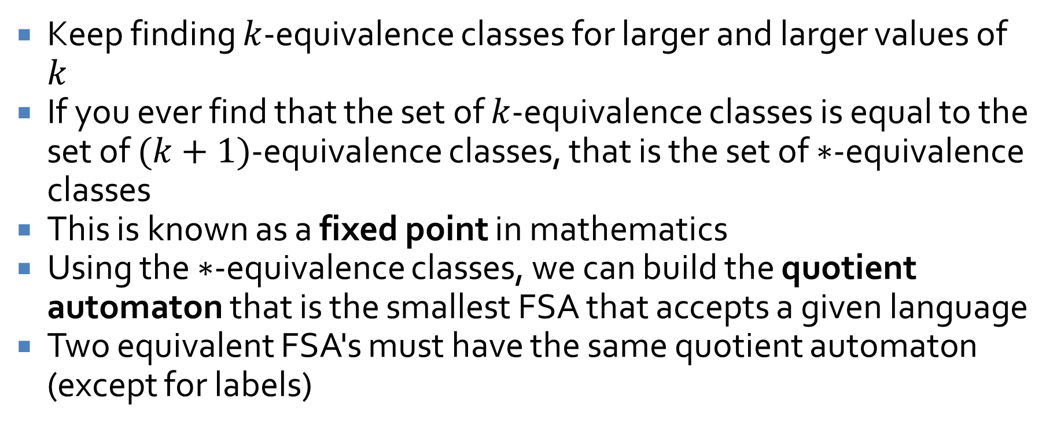
Finding the $∗$-equivalence classes
Keep finding $k$-equivalence classes for larger and larger values of $k$
If you ever find that the set of $k$-equivalence classes is equal to the set of $(k+1)$-equivalence classes, that is the set of $∗$-equivalence classes
This is known as a fixed point in mathematics
Using the $∗$-equivalence classes, we can build the quotient automaton that is the smallest FSA that accepts a given language
Two equivalent FSA's must have the same quotient automaton (except for labels)

Slide 40
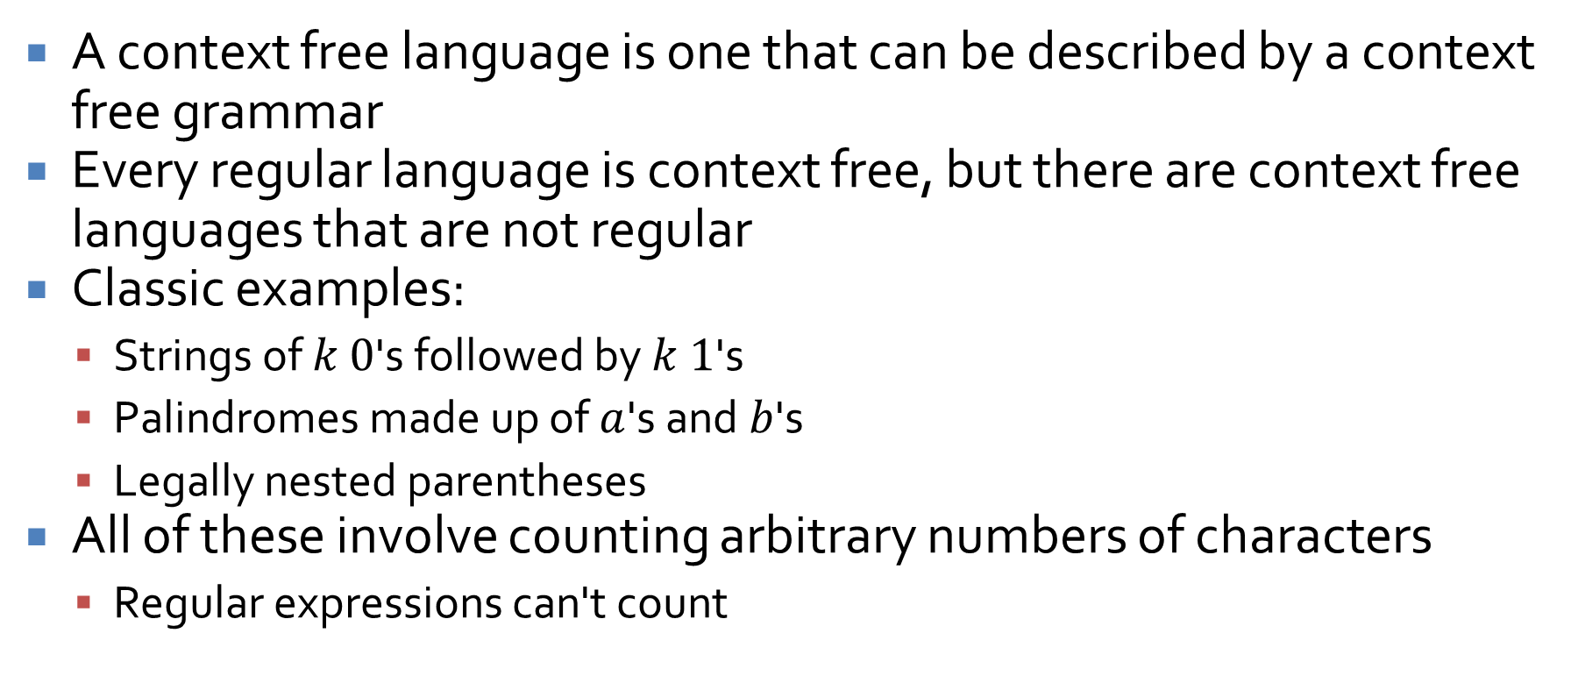
Context free languages
A context free language is one that can be described by a context free grammar
Every regular language is context free, but there are context free languages that are not regular
Classic examples:
Strings of $k$ $0$'s followed by $k$ $1$'s
Palindromes made up of $a$'s and $b$'s
Legally nested parentheses
All of these involve counting arbitrary numbers of characters
Regular expressions can't count

Slide 41
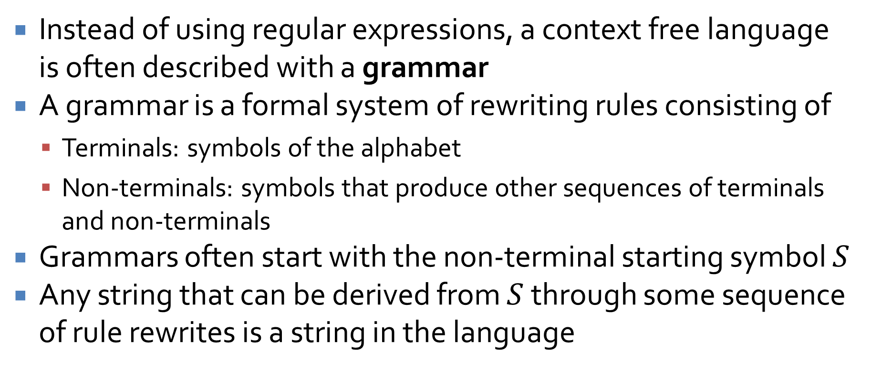
Context free grammars
Instead of using regular expressions, a context free language is often described with a grammar
A grammar is a formal system of rewriting rules consisting of
Terminals: symbols of the alphabet
Non-terminals: symbols that produce other sequences of terminals and non-terminals
Grammars often start with the non-terminal starting symbol $S$
Any string that can be derived from $S$ through some sequence of rule rewrites is a string in the language

Slide 42
Chomsky hierarchy
A grammar consists of terminals (alphabet symbols), non-terminals, production rules, and a start symbol
Chomsky noted that grammars can be divided into four levels in terms of expressiveness:
Type-0 (Unrestricted grammars)
Type-1 (Context sensitive grammars)
Type-2 (Context free grammars)
Type-3 (Regular grammars)

Slide 43
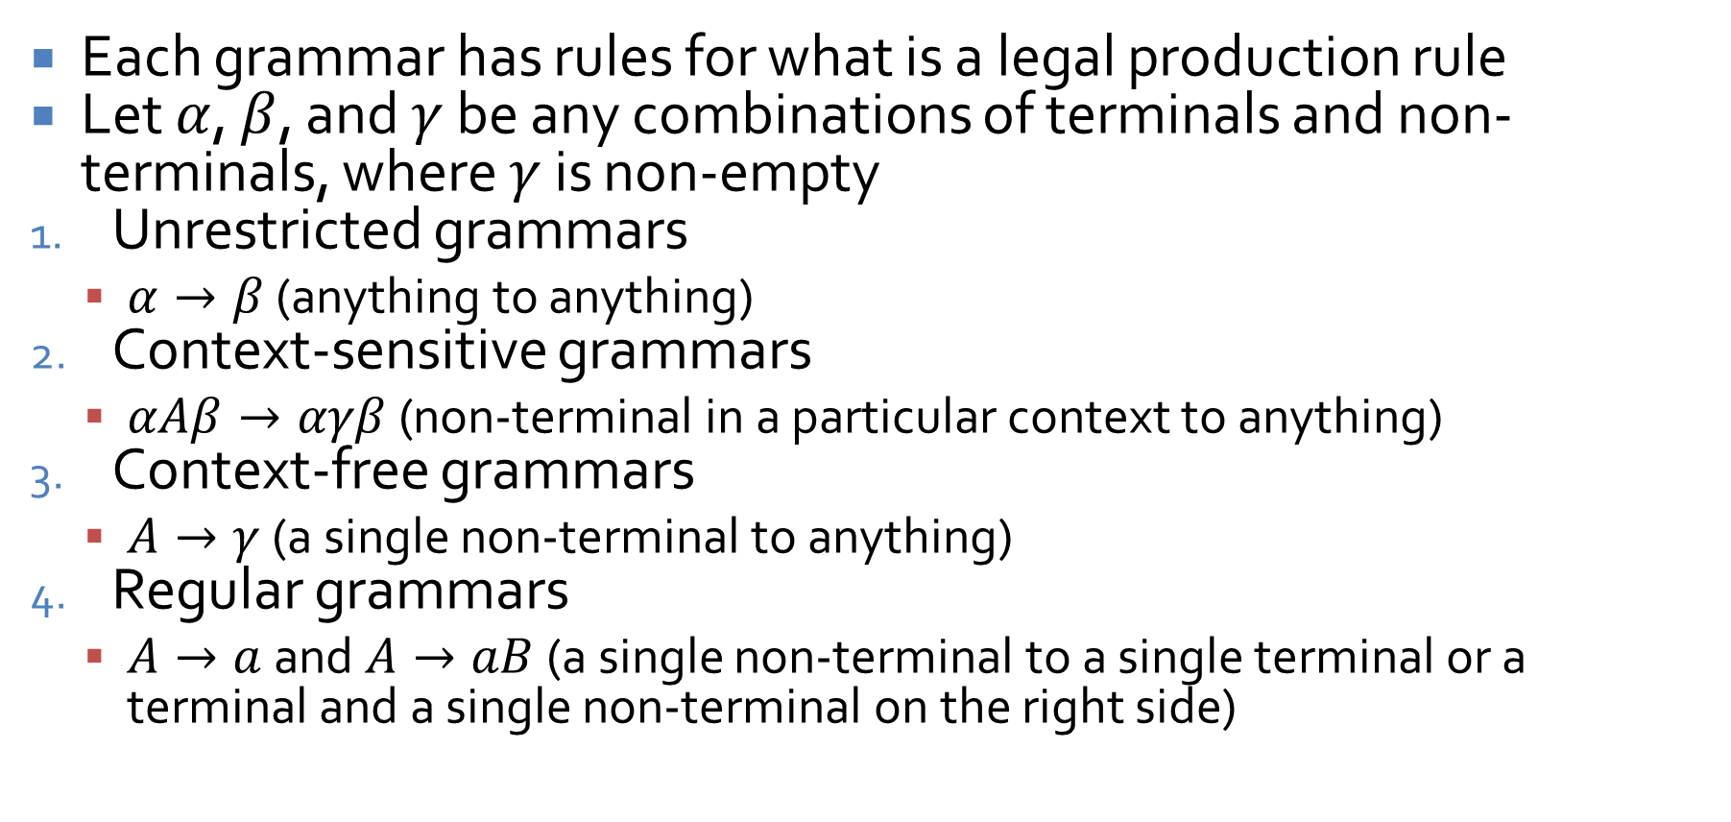
Rules for grammars
Each grammar has rules for what is a legal production rule
Let $α$, $β$, and $γ$ be any combinations of terminals and non-terminals, where $γ$ is non-empty
Unrestricted grammars
$α→β$ (anything to anything)
Context-sensitive grammars
$αAβ→αγβ$ (non-terminal in a particular context to anything)
Context-free grammars
$A→γ$ (a single non-terminal to anything)
Regular grammars
$A→a$ and $A→aB$ (a single non-terminal to a single terminal or a terminal and a single non-terminal on the right side)

Slide 44
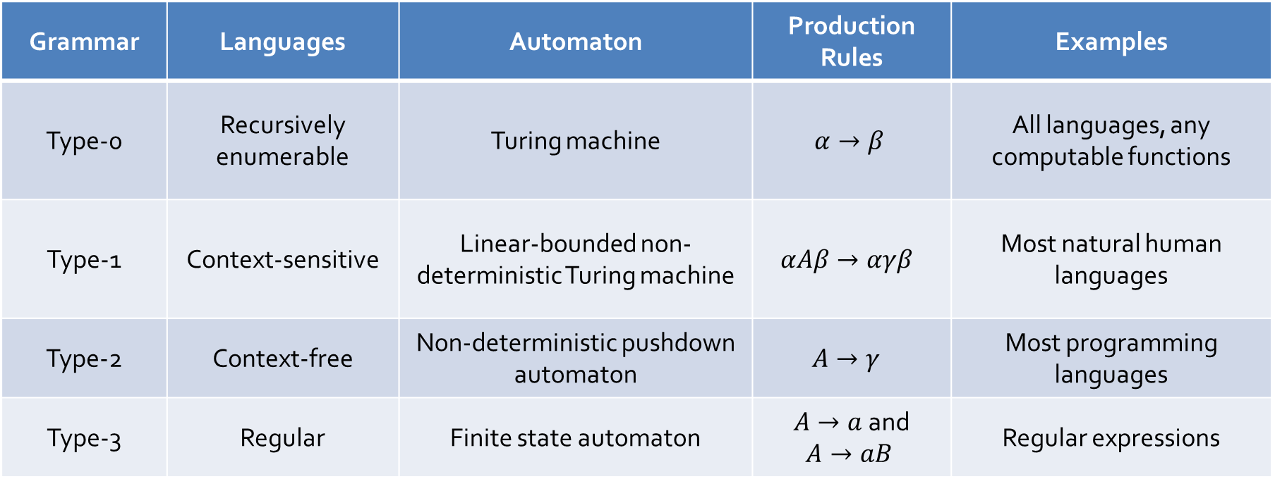
Languages broken down
Every kind of language has a particular kind of machine associated with it
Grammar | Languages | Automaton | Production Rules | Examples
Type-0 | Recursively enumerable | Turing machine | $$α→β$$ | All languages, any computable functions
Type-1 | Context-sensitive | Linear-bounded non-deterministic Turing machine | $$αAβ→αγβ$$ | Most natural human languages
Type-2 | Context-free | Non-deterministic pushdown automaton | $$A→γ$$ | Most programming languages
Type-3 | Regular | Finite state automaton | $A→a$and $$A→aB$$ | Regular expressions

Slide 45

Formal language practice
Write a regular expression that accepts strings that contain an even numbers of $b$'s, an odd numbers of $a$'s, and at least one $c$
Draw an FSA that accepts this language
Create a context-free grammar that defines this language

Slide 46
Upcoming

Slide 47
Next time…
There is no next time!

Slide 48
Reminders
Finish Assignment 6
Due tonight!
Final exam:
Wednesday, April 29, 2026
8:00 to 10:00 a.m.

